Slide 1
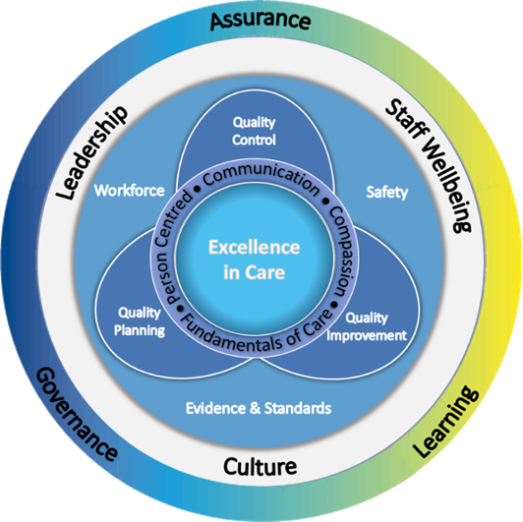
Quality of Care Review/Care Assurance Visit: Establish the Scope/Commission
Guidance to completing the Scope/Commission of a QoC Review
See QoC Review Guidance for full details
Consider the complexity and scope of the review to identify key participants and their responsibilities
Consider which of the elements of the EiC Framework are most appropriate to inform the questions being asked within the QoC Review, the best way to gather the required information and how this will be triangulated
It is not essential to use all of the elements, professional judgement and the scope of the QoC Review will determine which elements to use
Be curious - consider the benefits of combining elements from different sections of the EiC Framework to develop a new understanding of service
Consider how well you know your system? Record the understanding of those involved in the review on a Likert scale pre and post review
Note that some areas of practice will impact a number of different elements of the EiC Framework at the same time
Consider the format of the feedback, when it is required and creation/ownership of any action plan, what is appropriate to share with the clinical area

Slide 2
Quality of Care Review/Care Assurance Visit: Establish the Scope/Commission
Executive Sponsor: Lead Reviewer:
Reason for QoC Review
Examples include
Planned or scheduled
In response to a trigger (area delivering high quality care or area of concern)
Peer review (internal/external)
What are you seeking to understand?
Examples include
What questions are you seeking to answer?
Which elements of EiC framework will be used?
What are the enablers?
What are the barriers?
Governance/Reporting
Consider
Escalation route
Clinical and Care Governance meetings
Implementation plan/reporting expectations
Output – via professional judgement, RAG rating
Quality of Care / Care Assurance Visit Team: Consider who is involved, what support is needed for each Stage of the QoC Review Process and what their responsibilities are.
QoC Review Process: Timeline
Stage | Outcome/Milestone | Start Date | End Date
1. Scope | Agreed scope/commission
2. Data | Data sources identified and reviewed
3. Visit | Visit to clinical area/service
4. Triangulation | Themes from gathered data
5. Draft Report | Report: Qualitative and Quantitative data
6. Feedback | Initial feedback
7. Governance | Final report
Who is involved | Role and Responsibility
MDT Support
Clinical Area/Service
Staff Support
Data Analysis Support

